Slide 1
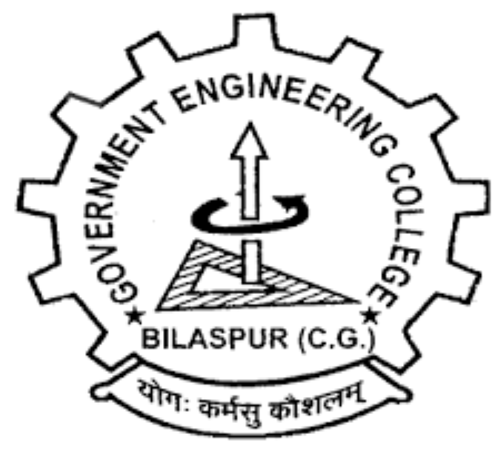
GOVERNMENT ENGINEERING COLLEGE BILASPUR
TOPIC: C programming language
PRESENTED BY: Astha Sahu, Anamika Ahirwar, Bhupendra, Bhumi Netam, Bhuneshwari, Bobby
ROLL NO.: 220, 219, 221, 222, 223, 224
SUB: Pmps (Programming for problem solving)

Slide 2
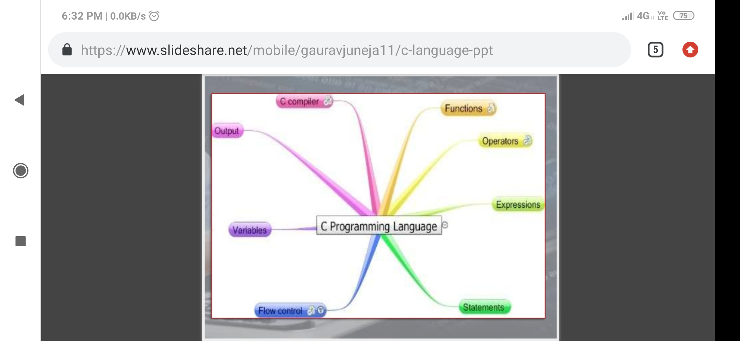
C language
Compiler
Functions
Output
Operators
Constants
C Programming Language
Variables
Running C program
Character set

Slide 3
Contents
Introduction
C Character set
Variables
Constants
Operators
Functions
Basic structure of “C” programs
Running a “C” program & Example

Slide 4
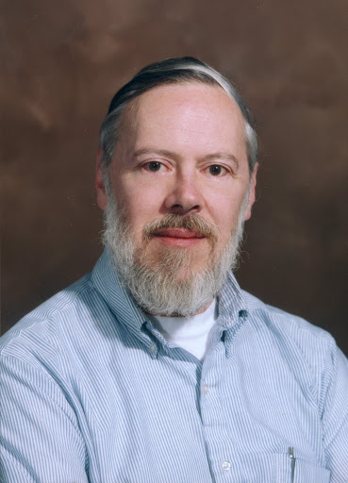
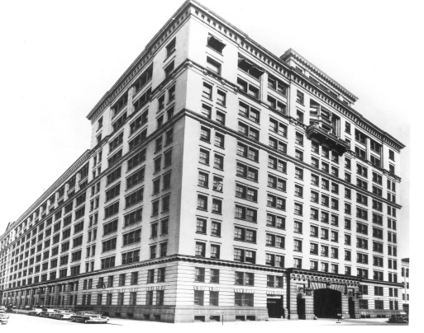

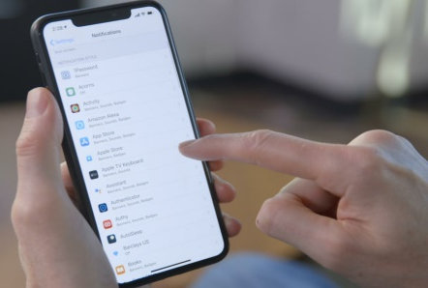
Introduction
Designed and developed by “Dennis Ritchie” at AT&T Bell Laboratories of USA in 1972.
C is a structured programming language.
C is powerful language.
Major parts of popular operating system like windows, UNIX, LINUX, etc. are written in C. This is because even today when it comes to performance nothing can beat C.
Mobile devices like Smart phones and Tablets have become rage of today. Also common consumer devices like microwave ovens, washing machines and digital camera are getting smarter by the day. This smartness comes from a program embedded in these devices. No wonder that such programs are written in C. This program not only run fast but also have to work in limited amount of memory, with this constraints on time and space C is the language of choice.

Slide 5
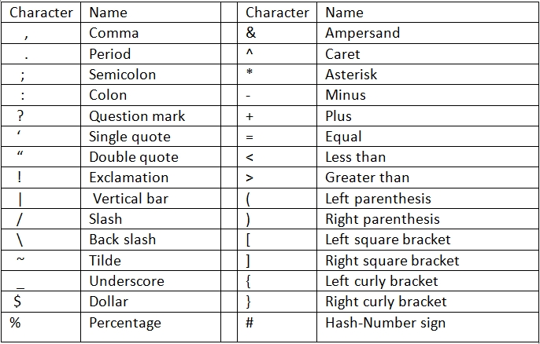
C character set
C does not use every character set and key found on modern computers. The only characters that C-Language uses for its programs are as follows:

Slide 6
Alphabets
Special Symbol
White Space
Digits
A-Z (Uppercase letters)
a-z (Lowercase letter)
0-9
#, %, &, !, ……. {}, [], $, &&, <, >, |+, -, /, *, = ,. : ; ‘ “
blank space, new line, tab, backspace etc.
C Character set

Slide 7
What are Variables in C ?
A Variable is a data name that is used to store any data value.
Variables are used to store values that can be changed during the program execution.
Variables in C have same meaning as variables in algebra. That is, they represent some unknown or variable value.
X = a + b
Z + 2 = 3(y - 5)
Eg; amount– used to store the value of money at the end of each year(after adding interest)

Slide 8
Naming Variables
Variables in C may be given representations containing multiple characters. But there are rules for these representations;
Variable name in C :
May consist of letters, digits, and underscores(_), character
Should begin with a letter or an underscore(_).
May not begin with a number or digit.
May not be a keyword eg; if, void, for, while etc.
No Comma and blanks are allowed within a variable name.
No special symbol other than an underscore can be used in a variable name.
May be as long as you like, but only the first 31 character are significant.

Slide 9
Examples:
C is a case sensitive language. It matters whether an identifier, such as a variable name, is uppercase or lowercase.
Example; area
AREA
Area
ArEa
Are all seen as different variables by the complier.
Valid C variables
mark
Invalid C variable
2prize (digit)
Group one (Blank space)
Value
ph_value
x1
sum1
Char (keyword)
Prize$ (Dollar sign)
5th

Slide 10
Declaring Variables
Before using a variable, you must declare it to the compiler.
Declaration does two things;
It tells the compiler what the variable name is.
It specifies what type of data the variable will hold
Examples of variable declarations:
int length ; (integer type)
float area ; (decimal type)
double ratio; (real type)
Variables are separated by commas.
Eg; int number, total;
A declaration statement must end with a semicolon.
Eg; int sum;

Slide 11
Constants
Constants in C are the fixed value that do not change during the execution of a program.
Integer Constants
Real constants
Character constants
Single Character constants
String Constants
Numerical constants
C CONSTANTS

Slide 12
Constants Examples
Integer Constants
-Refers to sequence of digits such as decimal integer, octal integer and hexadecimal integer.
- Some of the examples are 112, 10, 0,-20 etc.
Real Constants
- The floating point constants such as 786, 0.0, -12.07 etc.
Single character Constants
- A single character constants contains a single character enclosed within pair of single quotes [‘ ’]. For example, ‘8’, ‘a’. ‘i’ etc.
String Constants
- A string constant is a sequence of characters enclosed in double quotes [“ ”]; for example, “0211”, “hello” , “143” etc.

Slide 13
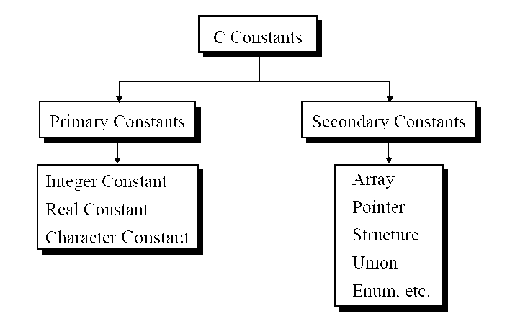

Slide 14
Declarations
Constants must be declared before they can be used.
A constant declaration specifies the type, the name and the value of the constant.
When you declare a constant, the compiler;
Reserves a memory location in which to store the value of the constant or variable.
Associates the name of the constant or variable with the memory location.

Slide 15
Operator
Specifies how an object can be manipulated.
an operator is a symbol that tells the computer to perform certain mathematical or logical manipulations.
Operator are used in program to manipulate data and variables. The data items that operators act upon are called operands.
Some operators require two operands, while others act upon only one operand. The operators are classified into unary, binary and ternary depending on whether they operate on one, two or three operands respectively.

Slide 16
ArITHmETic OPerators
These are used to perform mathematical calculations like addition, subtraction, multiplication, division and modulo division.
Operator | meaning
+ | Addition or unary plus
_ | Subtraction or unary minus
* | multiplication
/ | division
% | Modulo division

Slide 17
Relational operators
These operators are used to compare the value of two variables.
0perator | meaning
< | Is less than
<= | Is less than or equal to
> | Is greater than
>= | Is greater than or equal to
== | Is equal to

Slide 18
Conditional operators
These operators return one value if condition is true and return another value is condition is false.
For examaple,
a=10;
b=15;
X=(a>b)?a:b;

Slide 19
Increment and decrement operATORS
These operators are used to increase the value of the variable by one and decrement operators are used to decrease the value of the variable by one in C programs.
++ : increment operator - - : decrement operator
int i = 2; int i = 2;
i = i+1; i = i – 1;
i++; or ++i; i--; or ++i;
Increment operator decrement operator

Slide 20
Bitwise operator
These operators are used to perform bit operations on given two variables.
operator | meaning
& | Bitwise and
| | Bitwise or
^ | Bitwise exclusive or
<< | Shift left
>> | Shift right

Slide 21
Assignment operators
These are used to assign the values for the variables in C programs.
a =a+1
a =a-1
a =a*(n+1)
a =a/(n+1)
a =a%b

Slide 22
Logical operators
These operators are used to perform logical operations on the given two variables.
operator | meaning
&& | and
|| | or
! | not

Slide 23
Special operators
C supports some special operators of interest such as comma operator, size of operator , pointer operators and member selection operators.
operators | meaning
& | This is used to get the address of the variable.
* | This is used as pointer to a variable.
Size of () | This is gives the size of the variable.

Slide 24
Basic Structure of “c” Programs
# include<stdio.h>
# include<conio.h>
Void main()
{
other statements
}

Slide 25
Header files
The files that are specified in the include section is called Header File.
These are precompiled files that has some functions defined in them.
We can call those functions in our program by supplying parameters.
Header file is given an extension .h .
C source file is given an extension .c .

Slide 26
Main function
This is the “Entry Point” of a program.
When a file is executed, the start point is the main function.
From main function the flow goes as per the programmers choice.
There may or may not be other functions written by user in a program.
Main function is compulsory for any C program.

Slide 27
Running a ‘C’ Program
Type a program.
Save it.
Compile the program - this will generate an .exe file (executable)
Run the program (Actually the exe created out of compilation will run and not the .C file )
In different compiler we have different options for compiling and running.

Slide 28
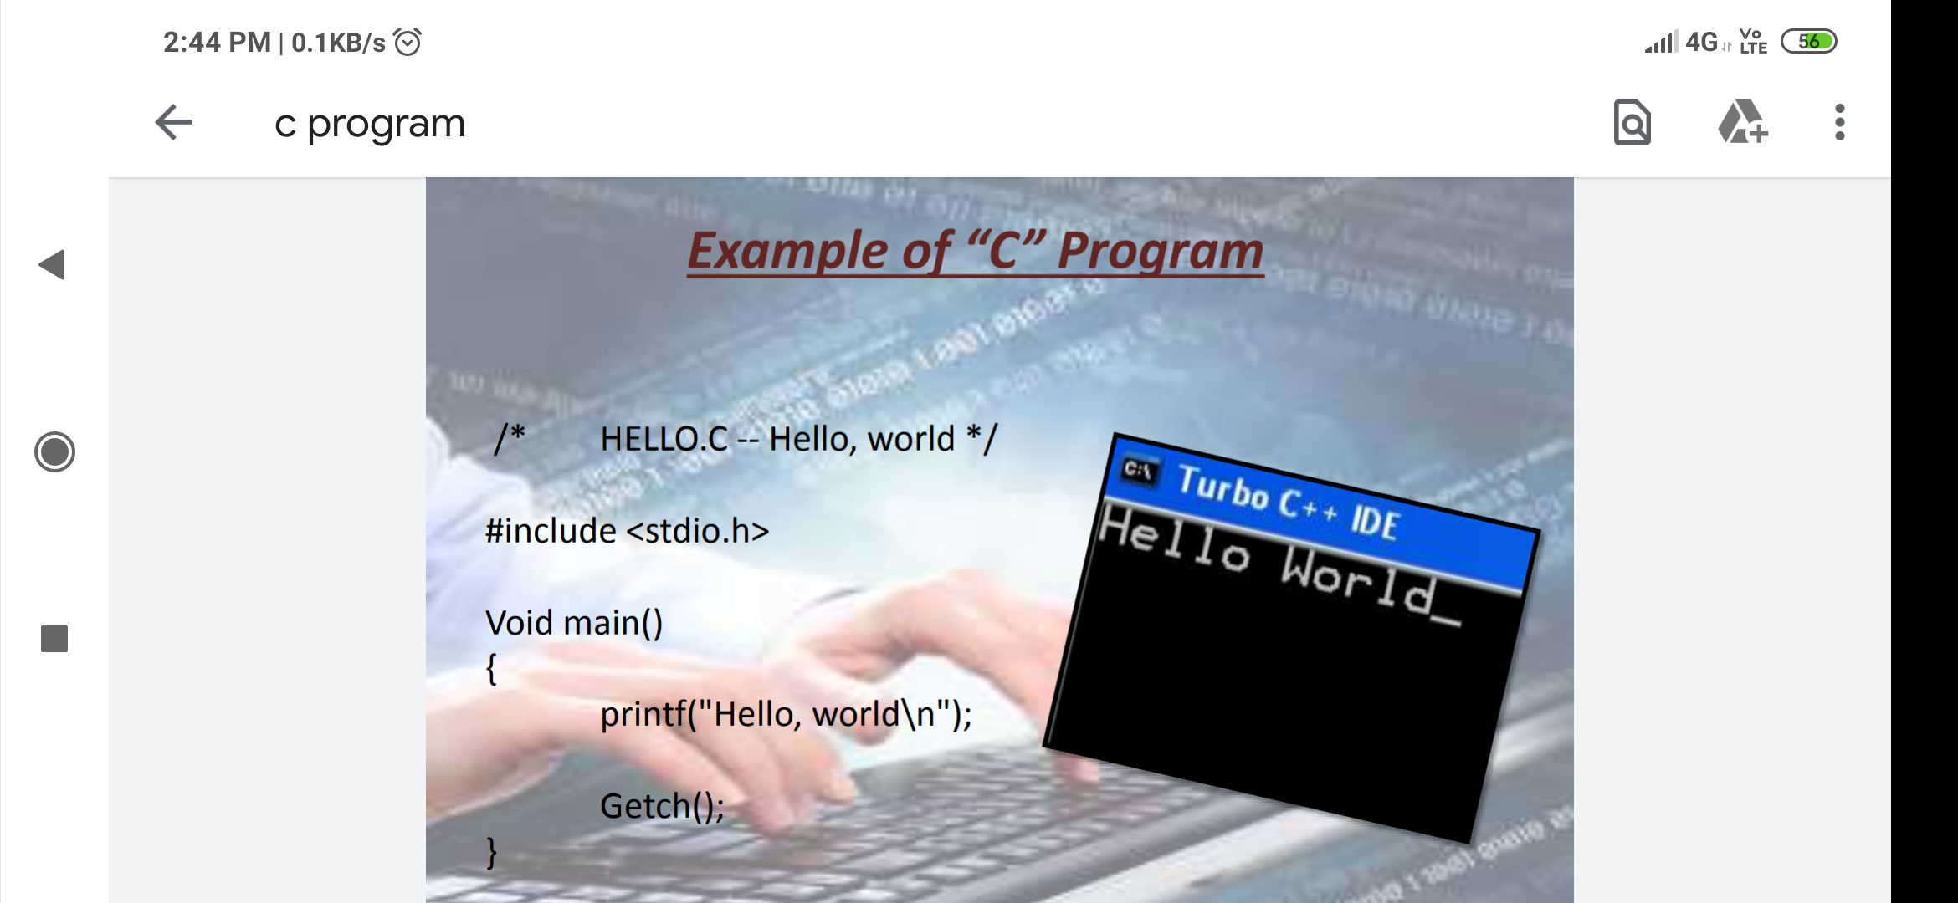
Example of “C” programming
/* HELLO.C—Hello, world*/
#include<stdio.h>
Void main()
{
Printf(“Hello, world\n”);
Getch();
}

Slide 29
WHAT IS A FUNCTION ?
A function is a self-contained block of statements that perform a coherent task of some kind.
Example:
Printf( ), scanf( ) etc.

Slide 30
PARTS OF FUNCTIONS
Function Prototype (function declaration)
Syntax:
dataType functionName (Parameter list)
Function Definition
Syntax:
returnType functionName(Function arguments)
{ //body of the function }
Function Call

Slide 31
TYPES OF FUNCTIONS
Built-in(Library) Functions
The system provided these functions and stored in the library. Therefore it is also called Library Functions.
Example: printf(),scanf() etc.
User Defined Functions
These functions are defined by the user at the time of writing the program.
Example: calsum(), sandwitch (),sugar() etc.

Slide 32
#include<stdio.h>
/* function declaration */int addition(); int main()
{
/* local variable definition */ int answer;
/* calling a function to get addition value */ answer = addition();
printf("the addition of the two numbers is: %d\n",answer);
return 0;
}
/*
function returning the addition of two numbers */int addition()
/* local variable definition */ int num1 = 10, num2 = 5;
return num1+num2;
}

Slide 33
Thank you

